Slide 1
Cognitive Enterprise Data Platform (CEDP) Primer
January, 2016

Slide 2
Vision Statement
CEDP is a world-class enterprise data infrastructure that integrates strategic cognitive IBM offerings on a cloud platform with our enterprise environment to consolidate and make available IBM's rich data resources in an unprecedented way. This platform and its services will transform IBM into a cognitive business enterprise through cognitive services and providing means to share and integrate data in fundamentally new ways. The key offerings are Cognitive Enterprise Data Lake (CoEDL), cognition services (CaaS), data services (DaaS), and trust services (TaaS). Through these interfaces, IBM Business and Functional Units will interact with the platform as producers and consumers, i.e., both contributing to and using its capabilities.

Slide 3
CEDP: Offerings
Cognitive Enterprise Data Lake (CoEDL)
Policy enforcement on owning (define policies), writing (generate and overwrite) and viewing data
Cognitive analytics for structured data (SPSS, RStudio, Notebooks) Annotators for unstructured data (e.g. BigInsights Web Interface for SystemT, Watson Knowledge Studio for SIRE) Deploy and execute cognitive analytics and annotators
Data-as-a-Service (DaaS)
Automated ingestion of streaming and batch data
Out-of-the-box tools for querying, exploring, dashboarding, and executing pipelines over datasets
Trust-as-a-Service (TaaS)
Access Governance Data lineage
Automate retraining (Self-Learning) of cognitive analytics
Cognition-as-a-Service (CaaS)
Accessing data for analysis and manipulation
Repository of Data (all types) organized to support applications and personas
Self-service tools, Sandboxes, social and collaborative tool
High scale data ingestion
360-degree view of data
Natural language interfaces
Social Signals
Single enterprise-wide catalog

Slide 4
CEDP v0.5 in Q42016
CEDP v0.5
Converged Catalog
Converged Datasets
Watson Data Platform
Sandbox
Client 360 Services
Support for Personas
User Interface
Deep Learning Solutions
Producers
Consumers
Ingest data from Data Sources
Ingest data for Reporting applications
Develop and Deploy Analytics jobs
Provide Technical Metadata
Submit requests through Forms
Provide access policies and authorize
Build reporting applications
Deploy analytical models
Ensure data quality
Provide business questions for CaaS
Real-time IOT data ingestion
Enterprise-wide Catalog to browse data assets
Obtain Client 360-degree views
Perform Analytics with data
Support Cognitive Process Initiatives
Support Business Applications through APIs
Submit requests through Forms
Develop self-service applications
Enterprise-wide governance
Obtains answers to Business questions
Share Trusted data within the enterprise
Alerts from real-time IOT data ingestion
Governance (TaaS v0.5)

Slide 5
CEDP v1.0 in Q42017
Producers
CEDP v1.x
Self Deploy
Self Learn
Self Heal
Self Serve
Instrumentation
DevOps
Cloud-based
Consumers
Ingests data for analytics
Ingests infrequently used data
Ingests data for sunsetting DW
Builds reporting applications
Deploys analytical models
Provides technical metadata
Ensures data quality
Provides business questions for CaaS
Real-time IOT data ingestion
…
Obtain 360-degree views
Perform analytics with data
Obtain reports
Enterprise-wide catalog
Enterprise-wide governance
Obtains answers to Business questions
Alerts from real-time IOT data ingestion
Enables Cognitive Process Initiatives
Share trusted data within the enterprise
…
Governance
Monetization

Slide 6
CEDP: Personas
Data Engineer
Data Scientist
App Engineer
Business Analyst
Subject Matter Expert
Ingests data for analytics and reporting applications
Deploys analytical models
Support Business Applications through APIs
Perform Analytics with data
Provide Technical Metadata
Ensure data quality
Develop self-service applications
Obtain Client 360-degree views
Support Cognitive Process Initiatives
Obtains answers to Business questions
Ensures Data Quality

Slide 7
CEDP: Timeline
Cognitive Q&A
CEDP 0.x
(Beta)
CEDP 1.0 (Alpha)
CEDP 1.0 (GA)
4Q2016 | 1Q2017 | 2Q2017 | 3Q2017 | 4Q2017
CEDP 0.x
(Cognitive Q&A)
CEDP 0.x
(GA)
CEDP 1.0 (Beta)
Cognitive Process Initiative

Slide 8
Data in CoEDL
Please note: Currently, not all datasets from the listed Data sources are ingested into the Lake.

Slide 9

CEDP v0.5 Architecture
Applications (CSA, Crystal, etc.)
Data Scientists (IBM DataWorks, SPSS)
Data Engineers (App ETL, Cognos ETL)
Data Discovery
Data Lake GUI
JDBC Connection
APIs
Web HDFS
User Interface Middleware
Data Services (WebSphere, DB2, Elastic)
Cognitive Services
Repository Services
User Authentication
360 API
Bulk data
CoRE
Cognitive Contracts
Query Generation (WebSphere)
Ontology
Data Delivery Area (Sandboxes)
User Defined Objects
Data Consolidation - IBM BigInsights
Spark
User/App Space
Data Governance (OneTeam, IBM security processes, etc.)
User Subscriptions
Files
JDBC
Key/Value
Oozie Workflows
Big SQL
Authorization, Audit, Lineage
Apache Drill
Integrated Data Area Zones
Linkage
Keys
Data Integration – IBM BigInsights
Curated Data
Federated Data Sources
Analytics Data
Schemata
Entity Resolution (Spark)
Reference Views
Available today
Data Catalog (IGC, Crystal)
Data Ingestion – IBM BigInsights
Landing Area Zones
In development
Oozie Workflows
Planned
Kafka
DB2
HDFS
Elastic
IBM Object
Storage
Key/ Value
SQL, DataStage, Logstash
Infrastructure
Encryption (at rest/in flight)
Cloud Computing and Storage
Raw Data Sources
CapIQ, DnB, Reuters, HG,
IDC, Orbit, etc.
Wikipedia, Patents, News, Glassdoor,
Twitter, etc.
Finance, Install Base, Contracts, Contacts, etc.
Streams
Licensed Data
Open Data
IBM Data
News
RSS

Slide 10





Data Flow & Services in CEDP v0.5
Metadata Management
Access Layer
Business Metadata (Glossary)
Catalog Front-End
Governance Catalog
- IBM Business Units
- Data Providers
Drop Zone
Landing Zone
(Access to raw data)
Integration Zone
(per use-case)
Data Extraction
(GUI)
Relational Tables
(HDFS)
Relational Tables
(HDFS)
Technical metadata
Technical metadata
Selection, Projection,
Join
Relational Tables
(HDFS)
data
Internal
Relational Tables
(HDFS)
Relational Tables
(HDFS)
File Access
(webHDFS)
DB2
DB2
Relational Tables
(HDFS)
Linkage &
Transformation
Spark, BigSQL
DataStage
Ingestion
Workflow
(Oozie)
Relational Tables
(HDFS)
Search
Indices (Elastic)
Relational Tables
(HDFS)
User / App Sandboxes
External
Relational Tables
(HDFS)
Client 360aaS
(REST)
webHDFS
Files
(HDFS)
data
Table definitions
Connect & Query
(QMF, DA,
DataWorks,
Cognos
SPSS
WEX)
Referenced Tables
(Federation)
Streams
Referenced Tables
(Federation)
Kafka
Object Store
(Cleversafe, S3)
Referenced Tables
(Federation)
table definitions
table definitions
JDBC / ODBC
(BigSQL)
Data Producers
HCatalog
Data Consumers
- CoEDP Infrastructure (ZC2, BigInsights, BigSQL, Spark, DB2, Infosphere Server, S3, Cleversafe)
- Security / Governance (Kerberos, Ranger, LDAP, Blue Groups, OneTeam, …)

Slide 11
Trust as a Service (TaaS) in CEDP v0.5
360° View of Trust
Quality
Metadata catalog contains business definitions
Catalog social engagement
Entity resolution and matching
Access
Acquisition
Apache Ranger managed authorization
All access logged and audited
IBM LDAP and BlueGroups integration
OneTeam managed access approval process
Sandboxes providing access only to approved datasets
EDL form template for new datasets
Business unit ingestion DoUs
One append-only landing zone
Automated workflow to populate metadata in catalog
CoEDL 0.5
Catalog
Metadata &
Definitions
Ingestion
Producers
DaaS/CaaS
Consumers
Data
Storage &
Computation
Security
Encryption in transit
Encryption at rest
Kerberos between systems
JDBC over TLS cryptographic protocol
No individual root access

Slide 12
Appendix

Slide 13
DataWorks Integration in CEDP v0.5
Watson Data Platform – CEDP 0.5 Features
Enterprise-wide CoEDL datasets (e.g. Client 360)
User and team sandboxes managed in Bluemix
Advanced analytics & cognition in notebooks
Cognitive services from Bluemix Watson
Access control policies mirrored from CoEDL
Best-of-breed IBM and open source technologies
Business Unit Data Producers
IBM Data
Sources
External Data
Sources
Drop Zone
HDFS, IBM CleverSafe, DB2
Apache Oozie Workflow
Data Scientist Consumer
CoEDL 0.5
Watson Data Lake
IBM CleverSafe
object store
Bluemix Data Connect
Database connector
Distributed FS
Apache Parquet
column-based files
Bluemix
Watson
Data analytics
VMs
Containers
Runtimes
WDP Projects
Notebook Code
Scala, R, Python (+ Spark)
Secure Gateway
ssh tunnel
IBM BigSQL
Accelerated SQL engine
Apache Hive
Storage model
and metastore
Data Assets Sandbox
Datasets from the Watson Data Lake
Apache Ranger
Authorization & Policies

Slide 14
Cognition as a Service (CaaS) in CEDP v0.5
Structured Data
ML Cognitive Analytics
Unstructured and
Structured + Unstructured
Advanced Analytics and Cognition
Bluemix
BlueCloud (Softlayer)
Watson Data Platform
Watson ML Service
Cognitive Solution App & UX
Notebook Analytics
BACC (or SPSS Client)
Custom R, Python, …
WEX
(e.g. document ingestion, annotation*, search)
SPSS Modeler
(e.g. neural nets,
regression models)
…
Sandboxes
(BigSQL, HDFS)
SB₁
SB₂
SB_{n}
Query-Level Analytics on Data
Spark
Enrichments
(e.g. Annotations, Entities)
…
Data
(e.g. Customer Info, D&B, News, etc.)
*In v1.0, transition to high-scale annotation with Watson Content Services (WCS)
Kafka
Enterprise Data Lake – Zurich Deployment

Slide 15
CEDP – Data Consumer Personas
Access Layer
Catalog Front-End
DB Engineer
Data Scientist
Data Management Tools
Data Studio / Architect
QMF
DB2
…
Data Extraction
(GUI)
Analytics Tools
Spark
SPSS
Cognos
WEX
File Access
(webHDFS)
Business User
Apps
CEDP User / App Sandboxes
Data Scientist
(on Bluemix)
Client 360aaS
(REST)
- Business Analyst
- Business Applications
Crystal+
SupplierIQ
ProspectIQ
CSA
Client Expansion
….
Bluemix Data & Analytics Services
Connect & Query
JDBC / ODBC
Watson Data Platform
(DataWorks)
Security Gateway
DaaS
IBM Blue Zone
Public / Bluemix Services

Slide 16
CEDP: Features and Terminology
Enterprise-wide Catalog
Sandbox
Social / Collaborative
Structured / Unstructured Data
Scale
SME Q&A
360-degree Views
Trusted
Secure
Governed
Self-Service
Common Data Platform
DaaS
CaaS
TaaS
Intuitive Interface
Cognitive Processes
Personas
Migration of DataMarts
Deep Learning

Slide 17
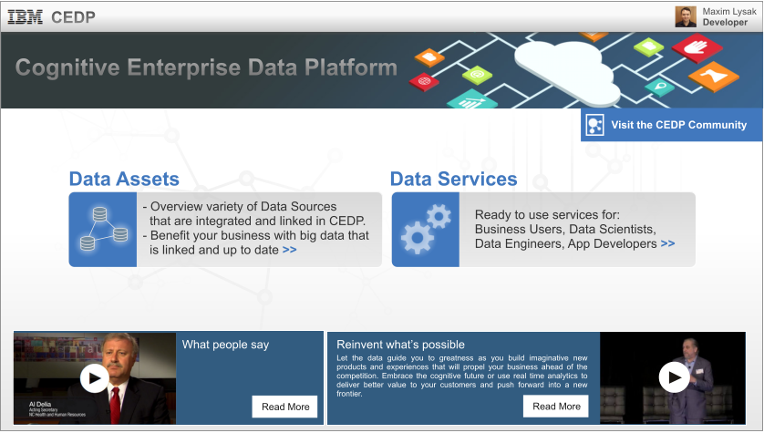
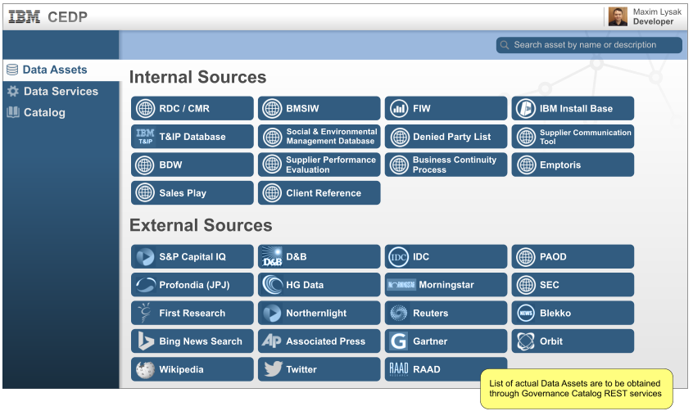
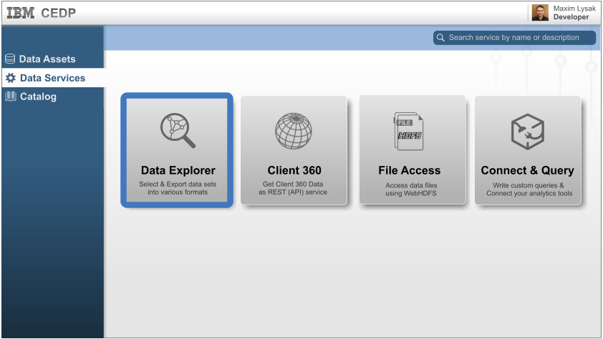
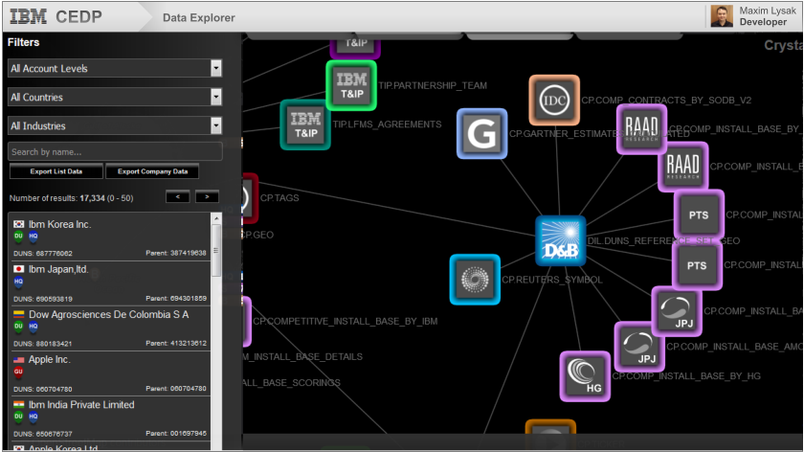
User Experience

Slide 18
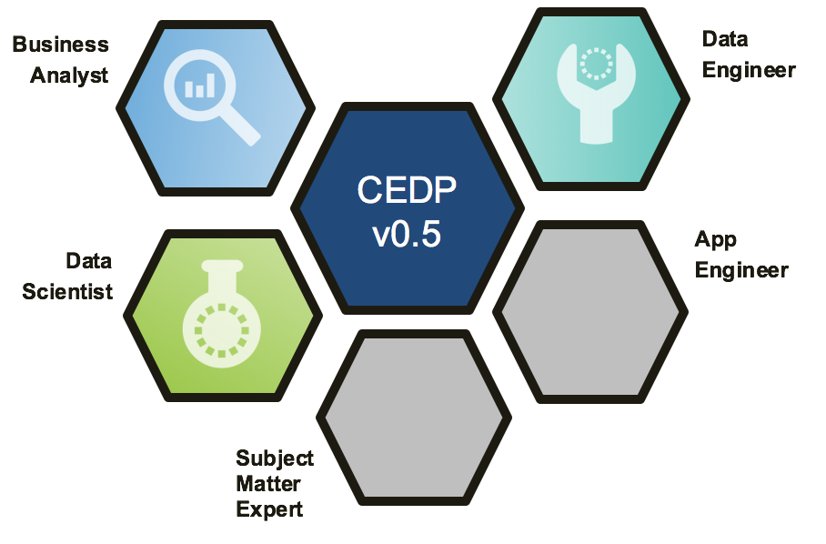
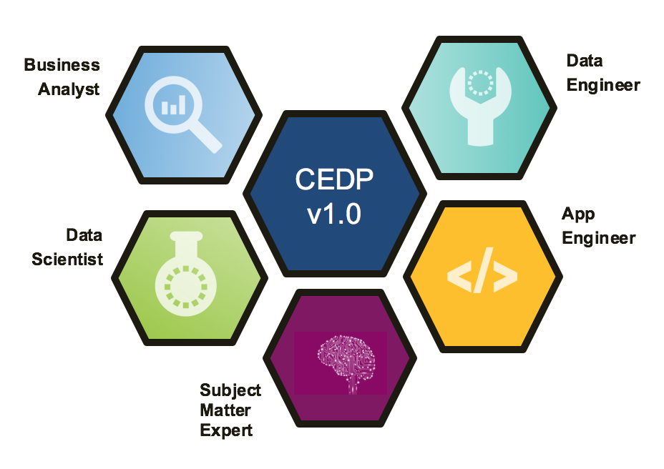
CEDP support for Personas
CEDP v0.5
(Q4 2016)
CEDP v1.0
(Q4 2017)

Slide 19
CEDP Timeline
Q4’17
Q3’17
Release 1.0 GA
Trust-as-a-Service: Automated enforcement of governance policies – GDPR compliant
Secure access from any platform (PC, iOS, Android)
Enterprise – wide cognitive catalog of data assets, notebooks, queries & dashboards
Q2’17
Release 1.0 Beta
Deep Learning & Natural Language Query for critical business questions & answers
Data visualizations
Q1’17
Release 1.0 Alpha
Cognition-as-a-Service: Cognitive predictive models on structured data
Standardized answers to critical business questions
Q4’16
Release 0.5 GA
Data-as-a-Service: APIs and data views to deliver answers to critical business questions
Team/User sandboxes to support analytic & cognitive projects
Integration with Watson Data Platform
Deep learning solutions
Release 0.5 Beta
Cognitive Enterprise Data Lake: Critical data sets consolidated to form client 360º views
Cognitive Q&A (CAO/CDO) to answer critical business questions

